Slide 1
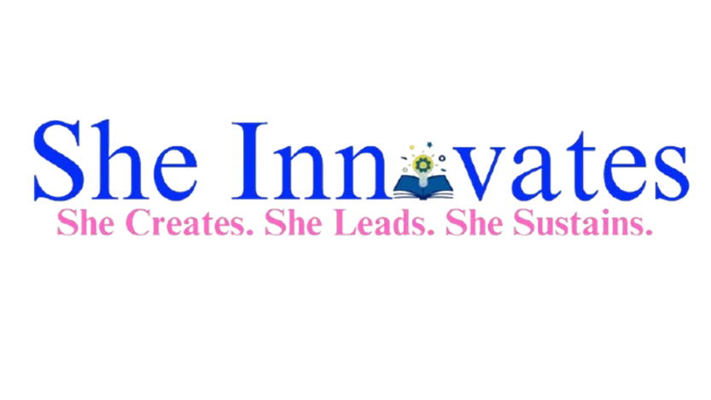

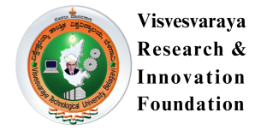
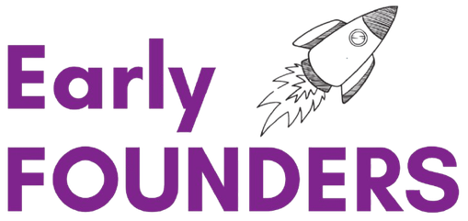


PERSONAL SAFETY IN PUBLIC & PRIVATE SPACE
COLLEGE-LEVEL
HACKATHON 2026
AKSHATA KAMBAR
Date: 26/02/2026

Slide 2
Problem Statement
02/11
Women and girls in STEM face problems like lack of relatable role models, limited mentorship access, biased hiring language, confidence gaps, lack of quality tech education.
We are solving the structural gender gap in STEM by building an AI-powered ecosystem that supports girls and women from education to leadership through inclusive learning, intelligent mentorship matching, bias-free hiring tools, and safe professional practice environments. This is a problem for girls in STEM education, early-career women engineers, women in remote areas with limited access to tech infrastructure, and tech companies facing gender imbalance and talent loss. This problem matters now because we are in a global AI-driven transformation. If women and girls are excluded from STEM pathways today due to lack of mentorship, bias, and access gaps, the next generation of technology will be built without diverse perspectives. Addressing this now ensures inclusive innovation and long-term economic growth.

Slide 3
Proposed solution & innovation
03/11
We are building an AI-driven platform that reduces gender gaps in STEM by providing accessible education, structured mentorship, bias detection, and confidence-building tools for women at every stage of their career journey.
What makes our solution better is that it addresses the complete STEM journey — from education to employment — using AI personalization, bias detection, psychological safety tools, and offline accessibility, making it scalable and inclusive.

Slide 4
Target Customers
04/11
Our primary target users are :
middle and high school girls, female STEM college students, and early-career women engineers.
Secondarily, we serve rural learners and tech companies aiming to improve diversity and inclusive hiring practices.

Slide 5
Competitor Analysis
05/11
There are platforms are there but they only focus on only one area but our solution combines all problems like personalized AI learning, smart mentorship, or bias free job readiness.
Girls who code : coding clubs and programs for girls and community support and awareness.
Limitations:- 1.Not personalized 2.Lack adaptive AI learning paths 3.No structured mentorship component
Code First Girls:- Free and paid coding courses for women and Focus on basic to intermediate coding skills
Limitations:-1.Traditional course model 2.No AI based personalization 3.No integrated mentoring or career guidance 4.Not optimized for rural or low-bandwidth users.
Advantage is that we provide a fully integrated, AI-powered ecosystem that addresses education, mentorship, bias reduction, confidence building, and rural accessibility something existing solutions currently offer only in isolated parts.

Slide 6
Value Proposition
06/11
Users will switch because we have an integrated of alla areas.
Users will switch because existing solutions address only isolated problems like coding or mentorship. Our platform provides a unified, AI-personalized ecosystem that supports learning, mentorship, confidence-building, and career growth in one accessible and inclusive system.
The most painful problem is the lack of structured mentorship and psychological safety for women in STEM, which leads to confidence gaps, career stagnation, and high dropout rates despite having the required skills.
Users will pay for outcomes that directly impact their careers — such as personalized mentorship, job placement preparation, interview simulation, and promotion readiness tools. Additionally, companies will pay for bias detection tools and structured diversity mentorship programs.

Slide 7
Role of AI & Efficiency Improvement
08/11
AI transforms implementation by automating personalization, mentor matching, bias detection, and performance feedback. It increases scalability, reduces cost, improves efficiency, and provides continuous intelligent support that would be impossible with manual systems alone.
AI improves solution efficiency by automating personalization, reducing manual coordination, lowering operational costs, and enabling scalable support for thousands of users simultaneously, resulting in faster skill growth and better career outcomes.

Slide 8
Expected Impact
09/11
Our platform increases STEM retention among girls, improves placement and promotion outcomes for women engineers, reduces confidence gaps, and supports inclusive hiring — creating measurable educational, professional, and societal impact.
Our solution creates social impact by n in STEM education and careers, reducing gender bias in hiring, empowering women economically, and bridging rural digital divides — contributing directly to long-term gender equality and inclusive innovation.
The future scope includes expanding into advanced deep-tech domains, global localization, enterprise integration for diversity analytics, AI-driven career forecasting, and building a global leadership network — positioning the platform as a scalable and sustainable ecosystem.

Slide 9
Conclusion
10/11
Our AI-powered platform empowers girls and women in STEM through personalized learning, career guidance, and inclusive hiring support, creating measurable impact in education, employment, and gender equality.
This platform is not just a technological solution it is a movement toward equal opportunity in STEM. By combining AI-driven personalization, confidence building support, and inclusive hiring practices, we aim to reduce gender gaps in education and careers. Our goal is to empower every girl and woman in STEM to learn, lead, and succeed creating a more diverse, innovative, and equitable future for society.

Slide 10

Thank You

